Slide 1
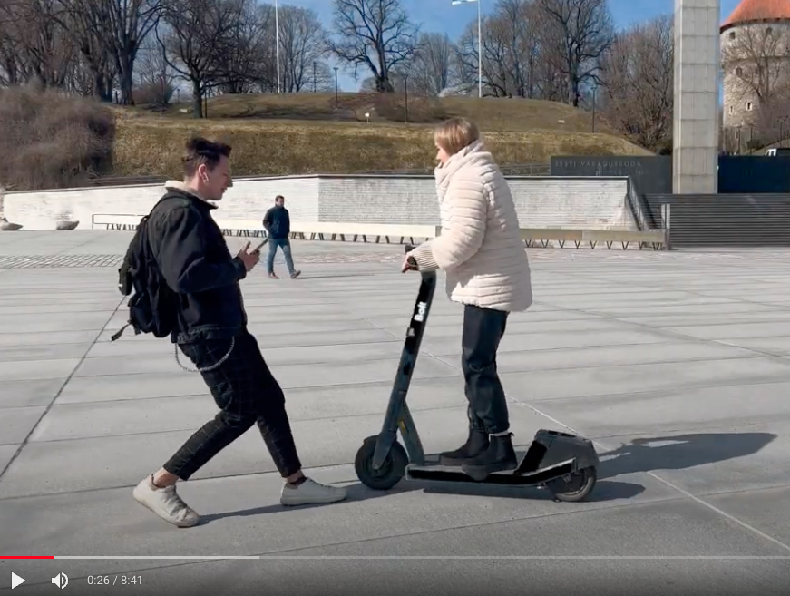
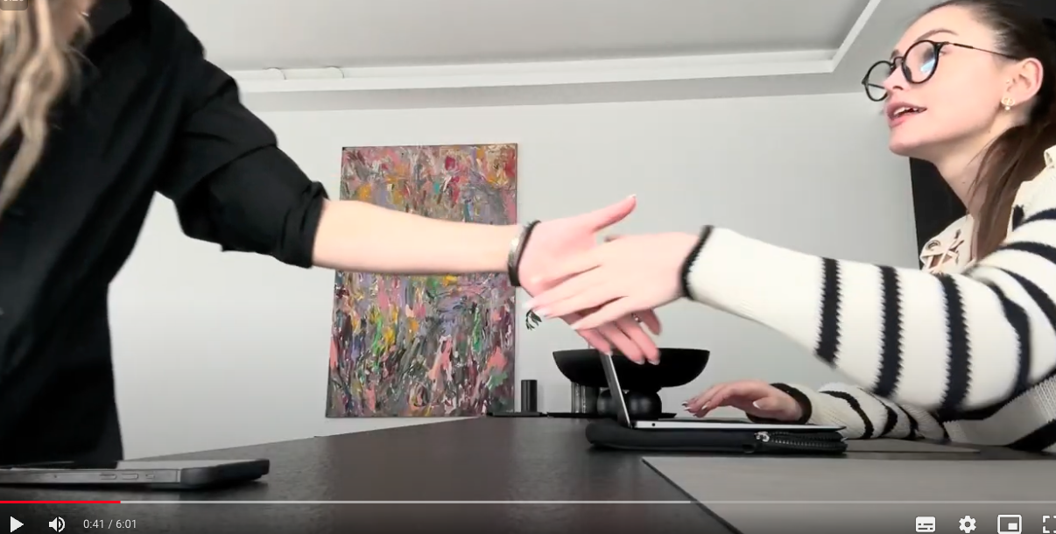
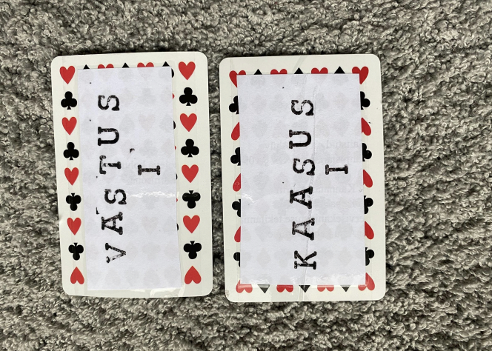
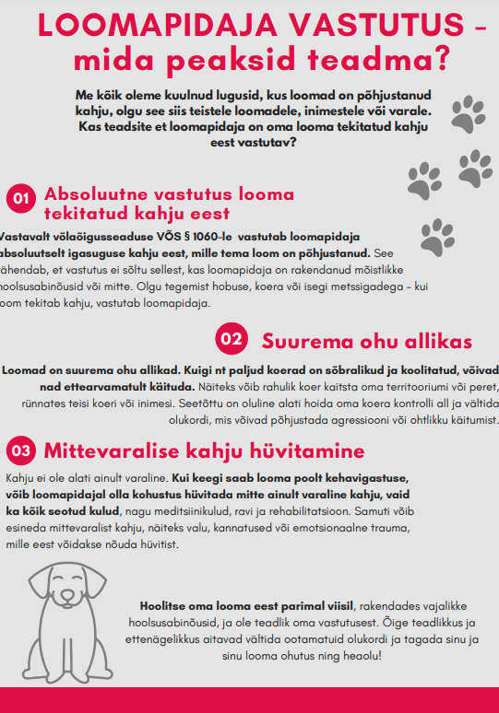
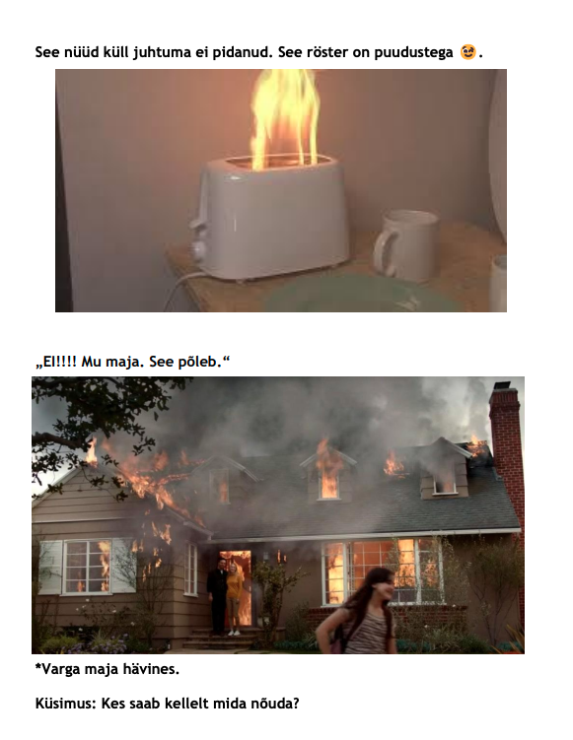
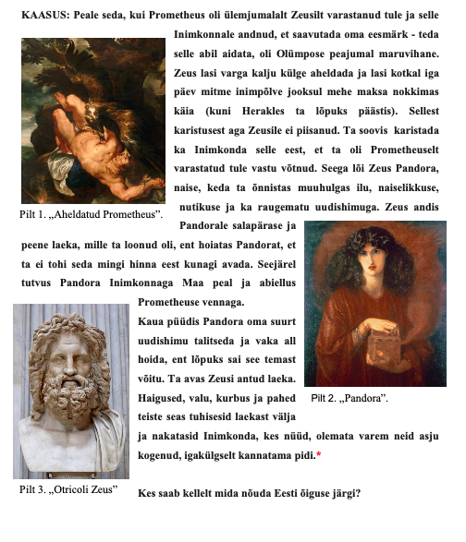
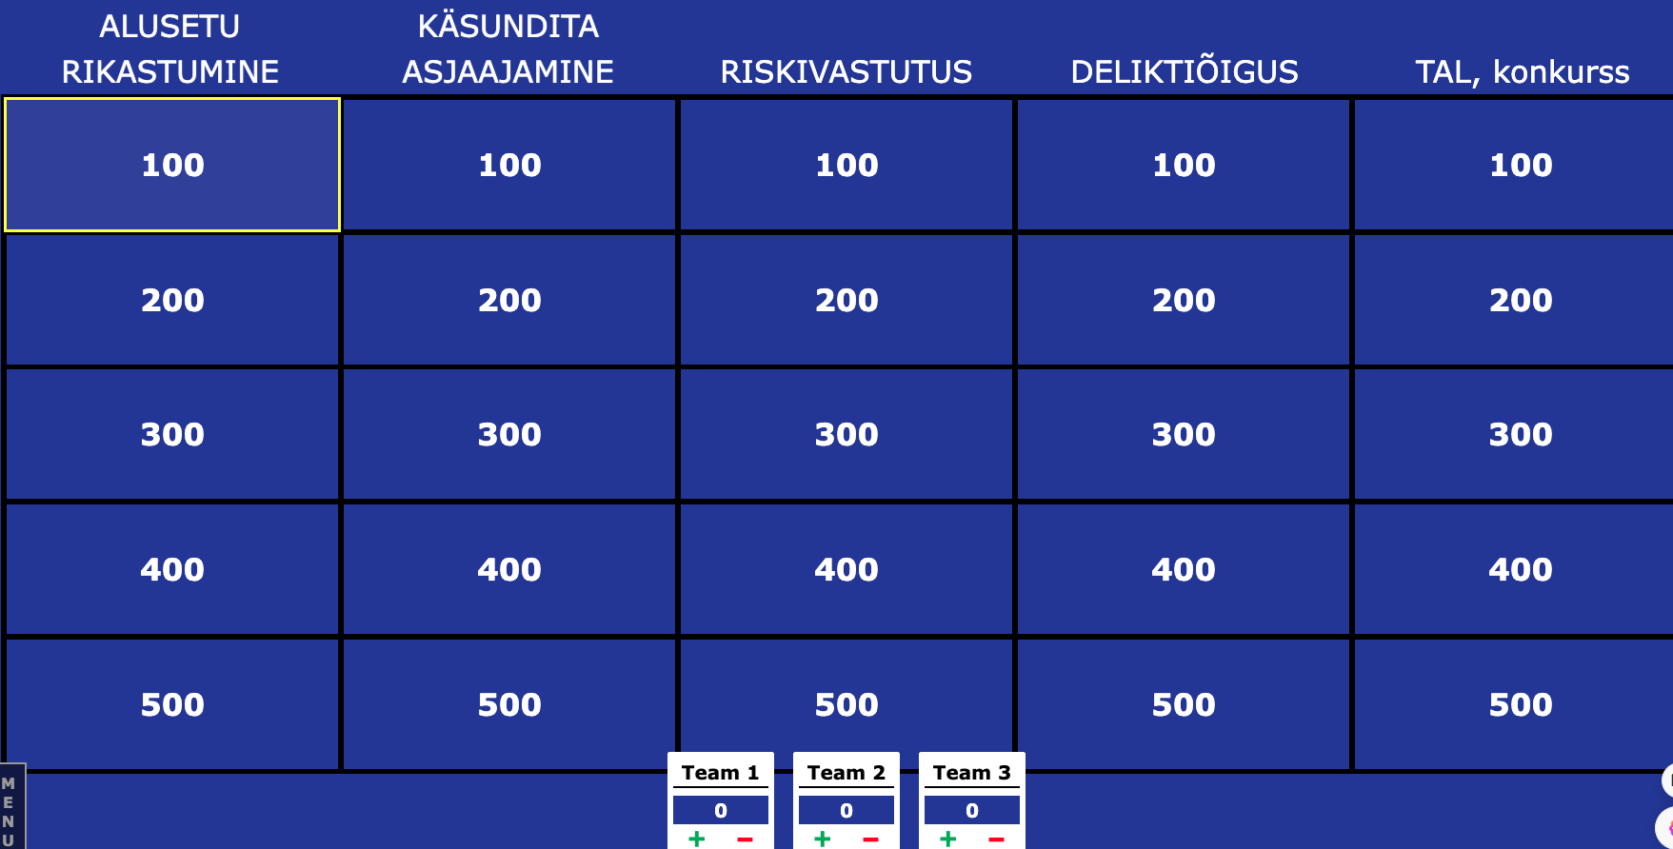
Creative assignments as a tool for enhancing learning
Introduction
Experiences and Examples
Teaching & Learning conference 2024
Students with a deep learning attitude aim for meaningful understanding of the material they are learning, they are interested in learning and perceive it as important, and they enjoy the learning process (Biggs & Tang, 2008). The teaching staff can contribute with their activities to the formation of a deep learning attitude in students, for example by using teaching techniques and tasks that activate students (Ramsden, 2003; Biggs & Tang, 2008). Studies have shown that students are activated and the emergence of a deep learning attitude is encouraged, among other things, by tasks that direct students to create something themselves based on what they have learned (Pegrum, Bartle & Longnecker, 2014; Cavazos, Stern, Stephenson & Heddy, 2012; Campbell, Heller & Pulse, 2022). The modified model of Bloom's taxonomy (Anderson & Krathwohl, 2001) clearly shows that cognitive intellectual skills are in a hierarchical relationship. This means that creative tasks require the learner to go through the levels of thinking prior to creation.
 | Total | Crossword | Video | Multiple choice | Jeopardy kahoot | Case analysis | Research paper | Other
2017 | 31 | 2 | 3 | 2 | 2 | 5 | 5 | -
2018 | 25 | 5 | - | 5 | 4 | 2 | 2 | -
2019 | 24 | 2 | 1 | 5 | - | 1 | 2 | Board game; Mindmap
2022 | 23 | 4 | 1 | 1 | 3 | 1 | 6 | Poster
2023 | 27 | 5 | 1 | - | 6 | 4 | - | Animation; TI-created cases
2024 | 29 | 2 | 2 | 4 | 12 | 4 | 2 | Board game; card game
Age Värv
Associate Professor
Tartu University, School of Law
age.varv@ut.ee
1
2
3
4
Course
5
6
7
8
9
Student authors: 1. Vain, A., Karaulova, E.; 2. Jukkum, J.; 3. Peterson, P., Shestakovski, N.; 4. Meeksa, M., Krjutškova, M.; 5. Herman, L., Lorens, E.; 6. Munk, B.; 7. Lohvart, M.; 8. Altma, C., Mark, R.; 9. Marjapuu, M., Kulemina, M.
Non-contractual obligations (P2OG.01.109)
compulsory course (law, BA)
6 ECTS
Student Feedback
“The requirement that the result of this assignment should facilitate learning in the given course has a disciplining effect, it helps to maintain focus and leads to deep thinking about the course material.”
“I liked that it was possible to see the learning objects created by my fellow students – it was a very good material to use when preparing for the exam.”
“It's good that we had a free choice regarding the form of the creative assignment. Even though making the video took a lot of time, but in the end it was fun and interesting, I feel that I learned a lot during this process.”
Assignment
creative assignment: an evaluable task (up to 5% of the points that form the basis of the final grade);
freedom of choice: performing creative assignment is optional;
aim: learning through creation, collaborative learning;
content: related to the course material;
form and type: any learning object that helps both its creator and fellow students to better understand the course material;
time frame: the work is submitted few weeks before the final assessment;
collaboration: learning object is created as a result of a team effort;
reflection: the students explain the choice of content and form of their work, including what they have learned in the process of making it.
Next Steps
It is necessary to analyze whether and how the instructions for the task and the evaluation criteria take into account the challenges posed by the AI.
References
Anderson, L.W., & Krathwohl, D.R. (2001). A taxonomy for learning , teaching , and assessing : A revision of Bloom's taxonomy of education objectives: complete edition . Addison Wesley Longman , Inc.
Biggs, J., Tang, C. (2008). Teaching that values learning at university. Tartu: Tartu University Press.
Campbell, L.O., Heller, S., & Pulse, L. (2022). Student-created video: An active learning approach in online environments. Interactive Learning Environments, 30(6), 1145-1154.
Cavazos, JT, Stern, W., Stephenson, E., & Heddy, B. (2021). Myth-busting with infographics: Do creative assignments help student learn ? Teaching of Psychology, 48(2), 117-123.
Pegrum, M., Bartle, E., & Longnecker, N. (2015). Can creative podcasting promote deep learning? The use of podcasting for learning content in an undergraduate science dream ​British Journal of Educational Technology, 46(1), 142-152.
Ramsden, P. (2003). Learning that teach in higher education (2nd ed.). London: Routledge Falmer.
MS Copilot

