Slide 1
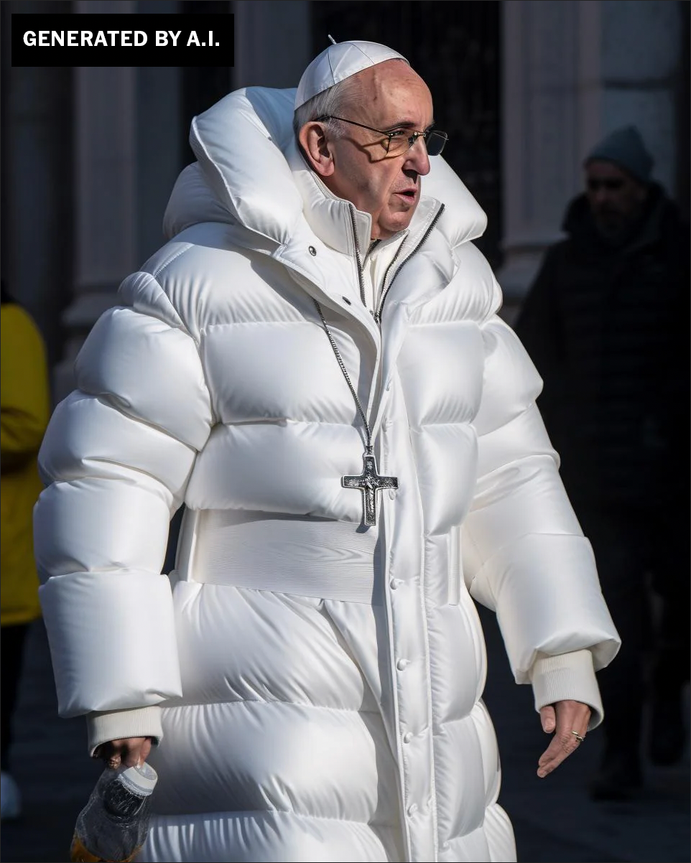
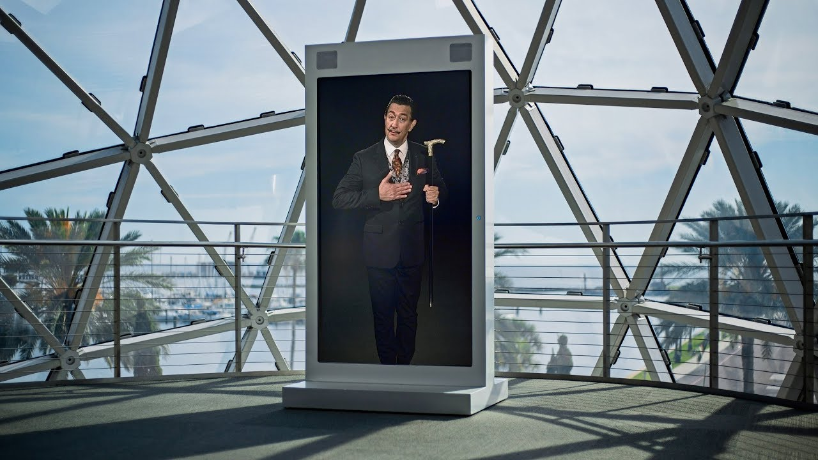
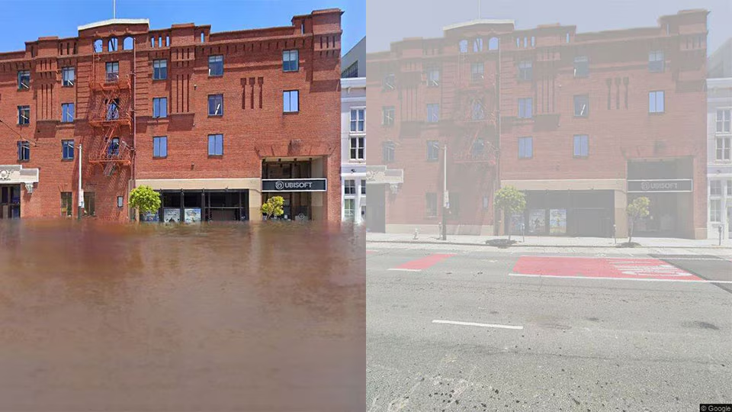
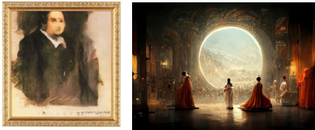
Exploring the Creative Applications and Positive Impacts of Deepfakes on Teaching and Learning Practices
Can YAVUZ ( can.yavuz@ugent.be )
Deepfake is synthetic but hyperrealistic audiovisual media (audio, photo, or video) that is entirely created or partially edited by a genAI system.
Why should deepfake be included in teaching and learning?
More engaging, visual, interactive, and personalized educational material
Novelty effect
Colavita visual dominance effect
Stimulate creativity
Job market’s needs
How to Use Deepfake in Teaching and Learning:
Drawing Inspiration from Deepfake Projects
JFK Silenced project created an audio deepfake of John F. Kennedy’s undelivered speech.
(Similar projects: In Event of Moon Disaster, Dimensions in Testimony)
Visual and Auditory
Teaching and Learning
Interactive Museums
Salvador Dalí Museum
Creative Visual
Advocacy Campaigns
This Climate Does Not Exist project illustrates how anywhere on Google Street View would look like with the environmental impacts of climate change.
(Similar projects: Listen to My Voice,
Digital Resurrection of Murdered Journalist Javier Valdez
Deep Empathy, Unfinished Votes)
Stimulating Artistic Creativity
Producing GenAI “Art”
Creative Advertising
Visit Denmark’s Deepfake-Powered Advertisement

